Slide 1
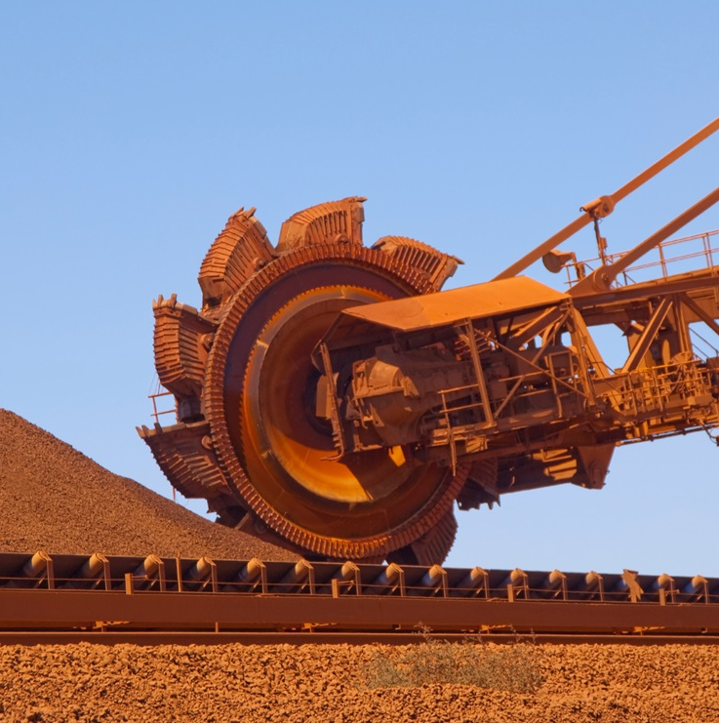
MARKET INTELLIGENCE
IRON ORE 2030
THE SUPPLY WAVE
CASE ANALYSIS: New Mines, Structural Surplus, and the Price Reckoning
Scope: Global Seaborne Iron Ore Supply | 2025-2030
April 2026 | Research & Analytics | Adarsh Sahu

Slide 2
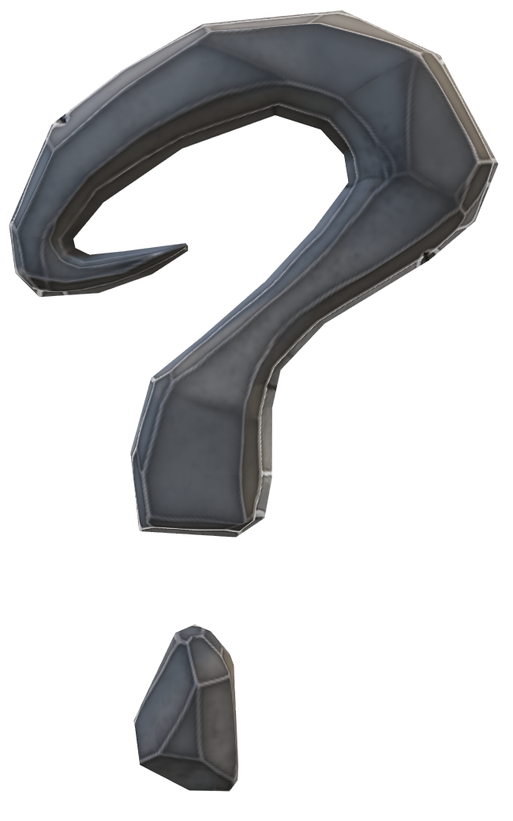
What This Study Addresses: Five Key Questions
OVERVIEW
1.
How big is the supply wave?
Who is adding tonnes, when, and at what cost. Three-wave pipeline 2025-2032.
2.
Gross vs. net - the critical distinction
Rio's ~130 Mtpa Australian replacement programme adds ~zero net seaborne supply. Most analyses miss this.
3.
What does Simandou actually add?
Rio's 5-10 Mt guidance = SimFer equity only. Combined WCS+SimFer = 25-35 Mt in CY2026. 3-4x more.
4.
India FY2026 = 310 mnt - lagging slight against steel production growth
FY2025 = 289 Mt. FY2026 = 310 Mt. Different fiscal years. Matters for supply-demand modelling.
5.
Where does price settle by 2030?
Base case $75-82/dmt (IODEX 61% Fe). Grade bifurcation: DR-grade resilient; 58% Fe discount widens.
Market Intelligence | Iron Ore 2030: The Supply Wave | April 2026

Slide 3
IODEX 62% → 61% Fe: What Changed and Why It Matters
BENCHMARK
Global iron ore fines index shifted from 62% Fe to 61% Fe specification effective January 2, 2026. Transitional 61/62% basis spread ~$1.5-2/t published.
Price Interpretation
Grade Spread Re-referencing
All 2026+ IODEX readings = 61% Fe basis. Historical 2021-2025 was 62% Fe basis. The ~$1.5-2/t difference is NOT material at a 5-year horizon. This study's 2030 scenario ranges ($65-100/t) are unchanged.
65%+ Fe premium: marginally wider in absolute $ vs. old 62% basis (lower base). 58% Fe discount: marginally narrower. Both directional trends unchanged. Simandou (65.3% Fe) is now 4.3% above the new 61% benchmark.
Why the Benchmark Changed
BHP-CMRG + Benchmark Coincidence
Pilbara ore grades have been declining for a decade. By 2025, the 62% Fe spec no longer reflected what was predominantly traded - PBF shipments tracked closer to 61% Fe. The shift reflects market reality.
The benchmark shift (Jan 2, 2026) and BHP-CMRG dispute coincided. Jimblebar fines (62-63% Fe) traded at -10-11% discount to the new 61% Fe index during the ban vs. normal -7-8%. Quality-adjusted pricing became more complex.
Market Intelligence | Iron Ore 2030: The Supply Wave | April 2026

Slide 4
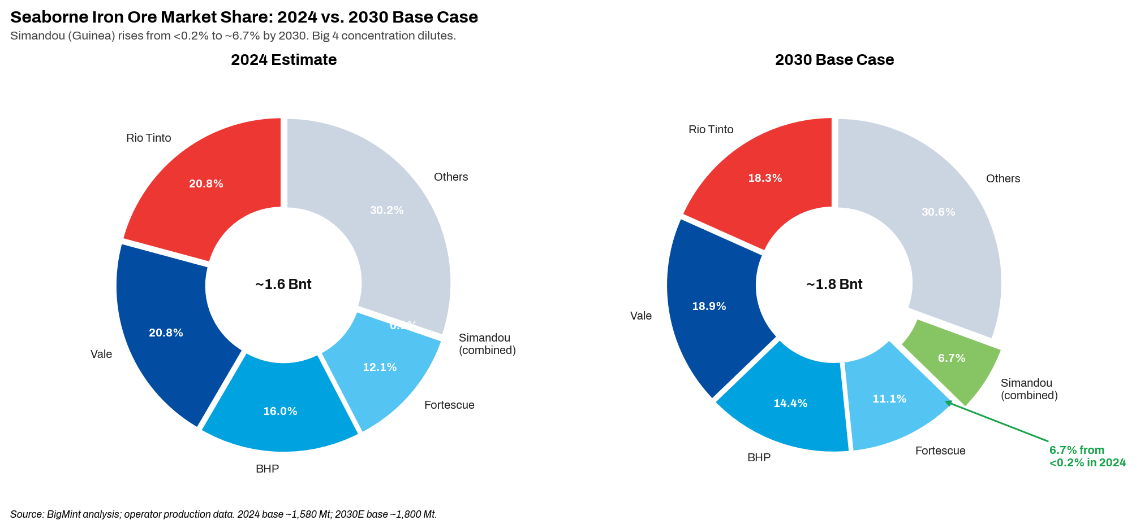
Seaborne Market Structure: Simandou Enters as 5th Major Exporter by 2030
01 | MARKET
~1.58 Bnt/yr
Seaborne trade 2024 base
~6.7%
Simandou 2030E share
(from <0.2%)
177.5 Mt
China port inventory Apr 2 2026 –
near-record price buffer
-10 Mt
China seaborne imports drop expected
in 2026 (~1.25 Bnt)
Market Intelligence | Iron Ore 2030: The Supply Wave | April 2026

Slide 5
Top 10 Producer League: Verified from Primary Filings (mnt)
02 | PRODUCERS
#
Producer
Country
CY2025 Output
2026 Guidance
C1 ($/t)
Tier
Key Verified Data Point
1
Rio Tinto
Aus/Guinea
336.6
343-366
~$24/wmt
T1
Q1 2026: 78.8 Mt Pilbara (+13% YoY). SimFer Q1=0.6 Mt (100% basis). Cash cost guidance $23.5-25/wmt.
2
Vale
Brazil
336.1
335-345
$21.3/t
T1
C1 $21.3/t explicitly stated in FY2025 6-K (SEC, Jan 28 2026). 7-yr high.
3
BHP (FY basis)
Australia
~260
258-269
~$18/t
T1
290 Mt wet 100% basis (record). FY2026 guidance equity basis. BHP-CMRG ban lifting Apr'26.
4
Fortescue (FY)
Australia
198.4
195-205
$19.04/wmt
T1
RECORD FY2025 +4% YoY. C1 $19.04/wmt stated H1 FY2026. Iron Bridge 67% Fe ramping.
5
WCS/Baowu
Guinea
~1.5
~15-25
~$24*
T1*
First shipper Dec 2 2025. Baowu 51% stake Jan 2026. WCS+SimFer combined = 25-35 Mt CY2026.
6
SimFer (Rio)
Guinea
~0.5
5-10
~$25*
T1*
Q1 2026 = 0.6 Mt 100% basis (Rio Q1 6-K Apr 21 2026). Rio guidance SimFer only.
7
NMDC
India
53 (FY)
53-56
~$32*
T2
Record prod. FY2026 +21% YoY (Apr 2026). Primarily captive domestic supply.
8
ArcelorMittal Lib.
Liberia
~9.5
~18
~$35*
T2
Nimba expansion. 245% increase CY2024 →2026E. Net new seaborne supply.
* = Author proxy. FY = July-June. BHP/FMG on FY basis. Simandou T1* = structurally new seaborne supply.
Market Intelligence | Iron Ore 2030: The Supply Wave | April 2026

Slide 6
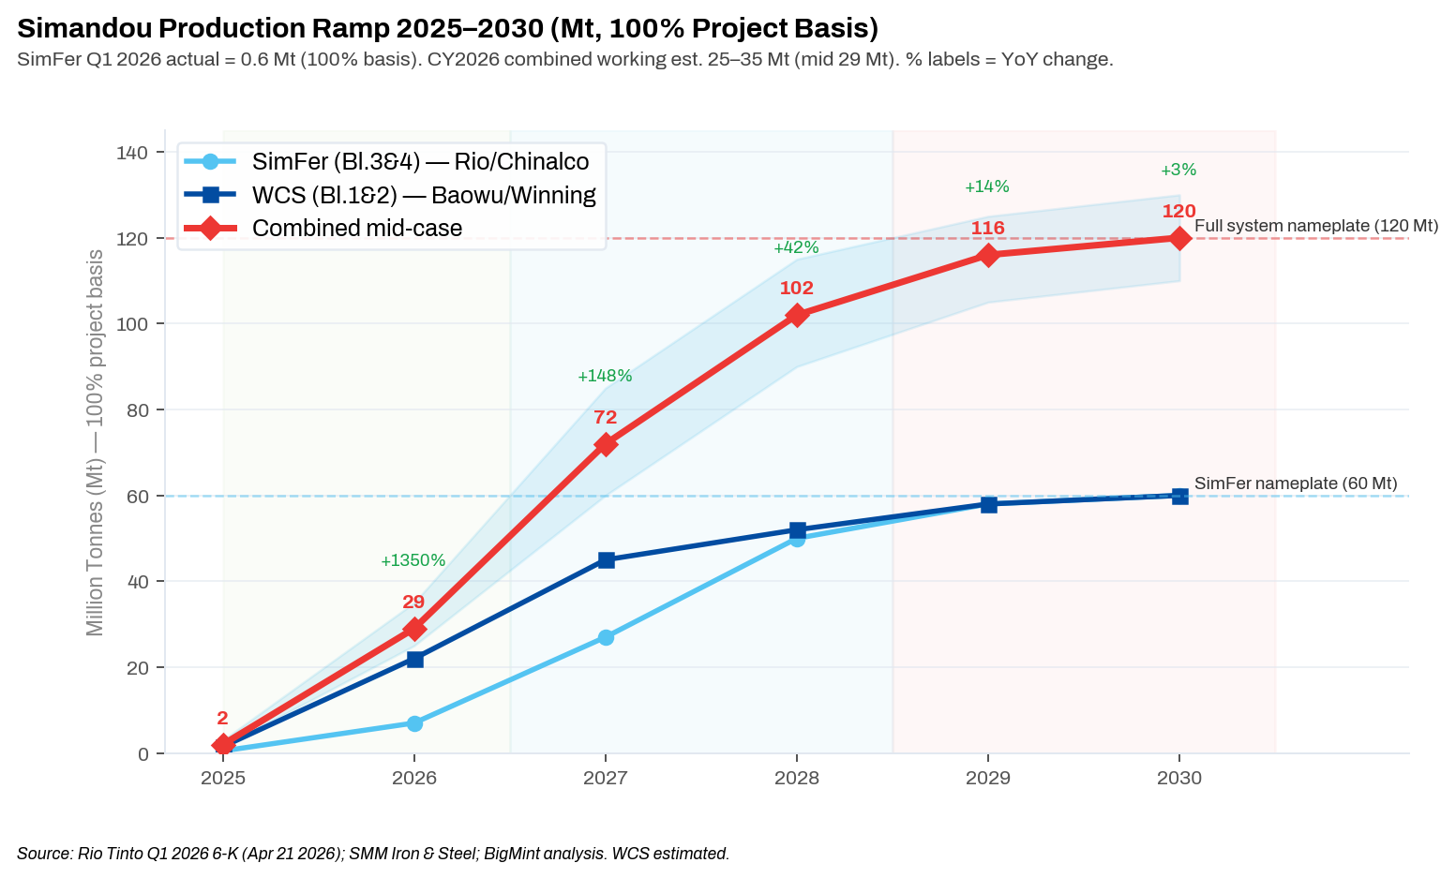
Simandou: Ramp Curve, Two-Block Structure & CY2026 Working Estimate
03 | SIMANDOU
~3.3 Bnt
Reserves at ~65.3% Fe avg - highest-grade new seaborne entrant
25-35 mnt
Working CY2026 combined est. WCS+SimFer (not Rio's 5-10 Mt equity)
0.6 mnt
SimFer Q1 2026 actual (100% basis) per Rio Q1 6-K Apr 21 2026
670 km
TransGuinean railway - 12 stations, 200+ bridges, 4 tunnels
65.3% Fe
Product grade is 4.3% above new IODEX 61% Fe benchmark
CRITICAL: Rio Tinto's "5-10 Mt" = SimFer equity share ONLY (Blocks 3&4, ~53% stake). WCS (Blocks 1&2, Baowu 51%) first shipped Dec 2, 2025 and is ramping FASTER. Combined CY2026 = 25-35 Mt. Using Rio's figure alone understates 2026 impact 3-4x.
Market Intelligence | Iron Ore 2030: The Supply Wave | April 2026

Slide 7
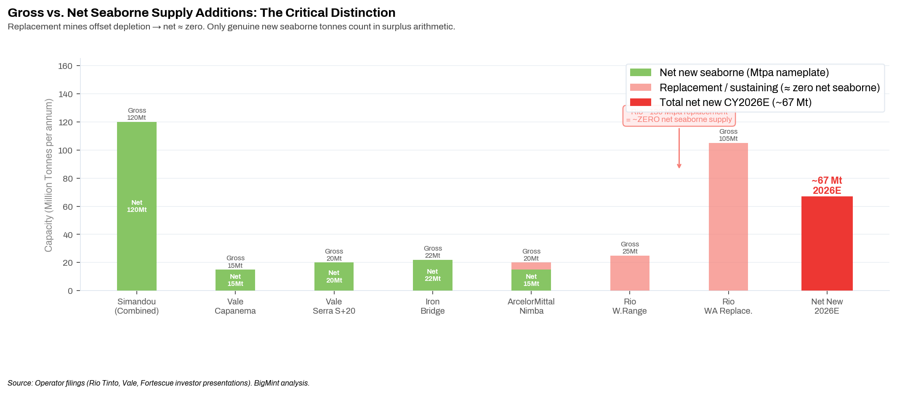
Gross vs. Net: The Most Important Analytical Discipline in Iron Ore Supply
04 | SURPLUS
Why Net ≠ Gross
Replacement mine
New mine offsets depleting pit at same operator. Net seaborne addition: ~ZERO.
Rio ~130 Mtpa programme
Western Range, West Angelas, Brockman Syncline 1 - all replacement. Maintain ~327 Mt Pilbara.
Genuine net additions CY2026
Simandou ~29 Mt + Vale ~15 Mt + Liberia ~12 Mt + Iron Bridge ~11 Mt = ~67 Mt.
The overstatement risk
Counting Rio's replacement tranche as new supply overstates the surplus by ~100+ Mt nameplate.
Market Intelligence | Iron Ore 2030: The Supply Wave | April 2026

Slide 8
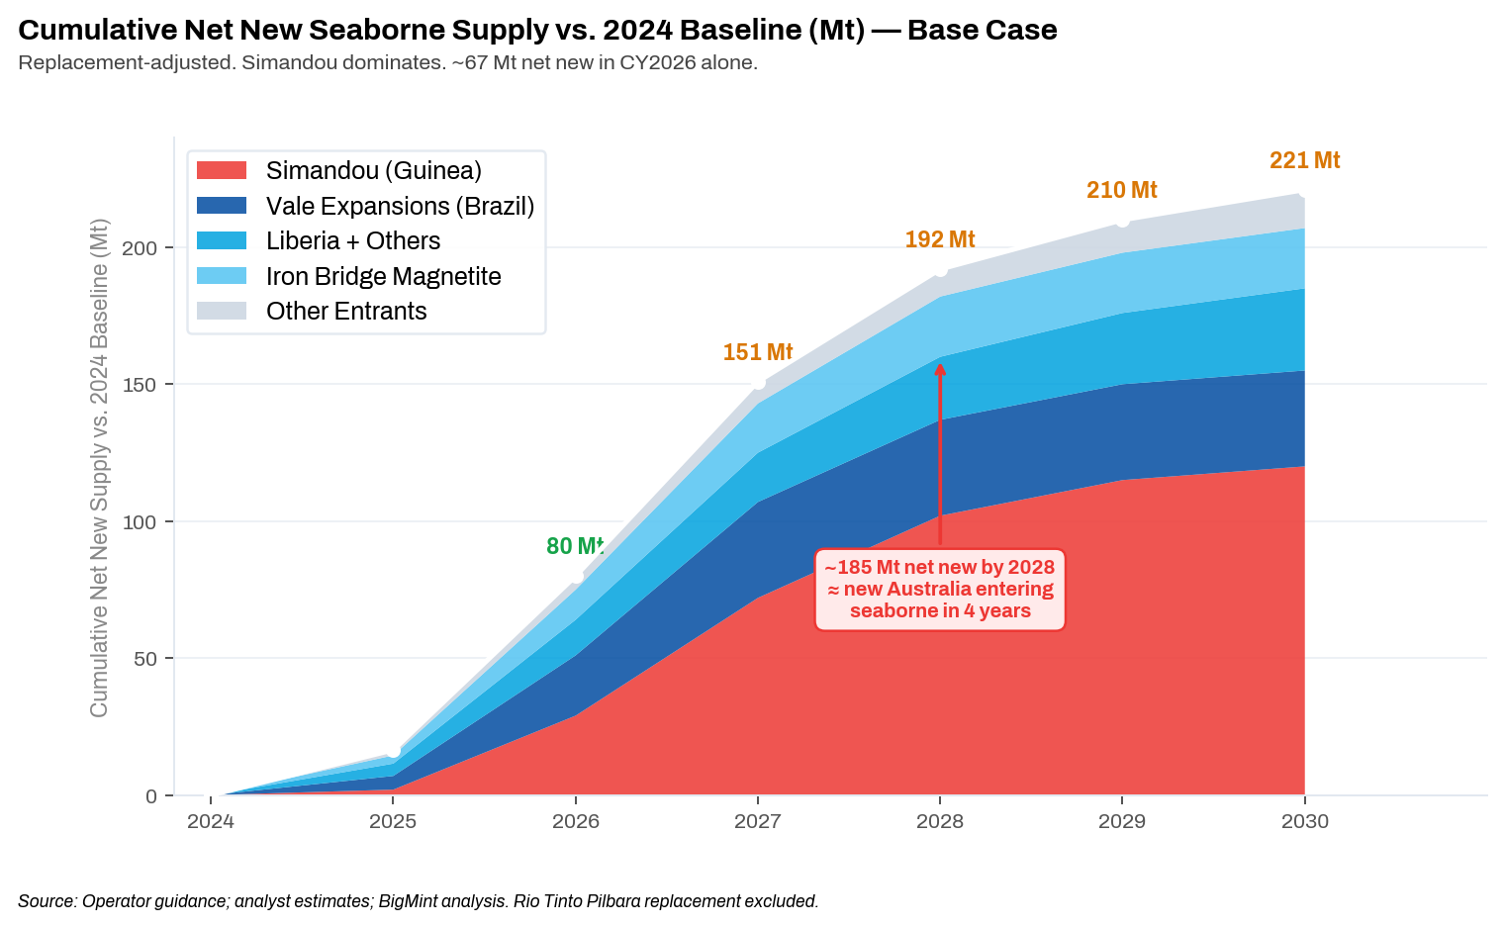
Cumulative Net New Seaborne Supply + The Inventory Buffer Mechanism
04 | SURPLUS
2-Stage Price Transmission
STAGE 1 —> 2025-2027
Net new tonnes arrive (~67 Mt in CY2026). Port inventory at 177.5 Mt (Apr 2) absorbs arrivals. 6-12 month price discovery lag. CURRENTLY ACTIVE.
STAGE 2 —> 2027-2029
Inventory normalises toward 130-145 Mt. Price pressure becomes direct. Base case $75-82/dmt by 2030. The price reckoning.
~67 Mt
~185 Mt
177.5 Mt
Net new seaborne CY2026
Cumulative by 2028
China port inventory Apr 2 2026
Market Intelligence | Iron Ore 2030: The Supply Wave | April 2026

Slide 9
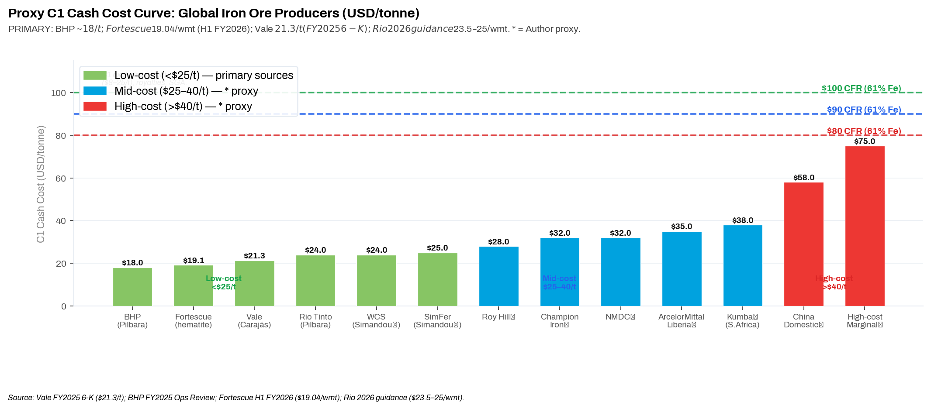
Proxy C1 Cash Cost Curve + Supply-at-Risk by Price Scenario (61% Fe IODEX)
05 | COST CURVE
$100/dmt CFR · ~5-8% at risk · ~80-130 Mt
$90/dmt CFR · ~15-20% at risk · ~240-320 Mt
$80/dmt CFR · ~30-35% at risk · ~480-560 Mt
China domestic marginal. All major seaborne exporters viable.
Roy Hill, Kumba at margin. ArcelorMittal Liberia at margin during ramp.
Kumba/Roy Hill loss-making. NMDC exports uncompetitive. China domestic curtailed.
Market Intelligence | Iron Ore 2030: The Supply Wave | April 2026

Slide 10
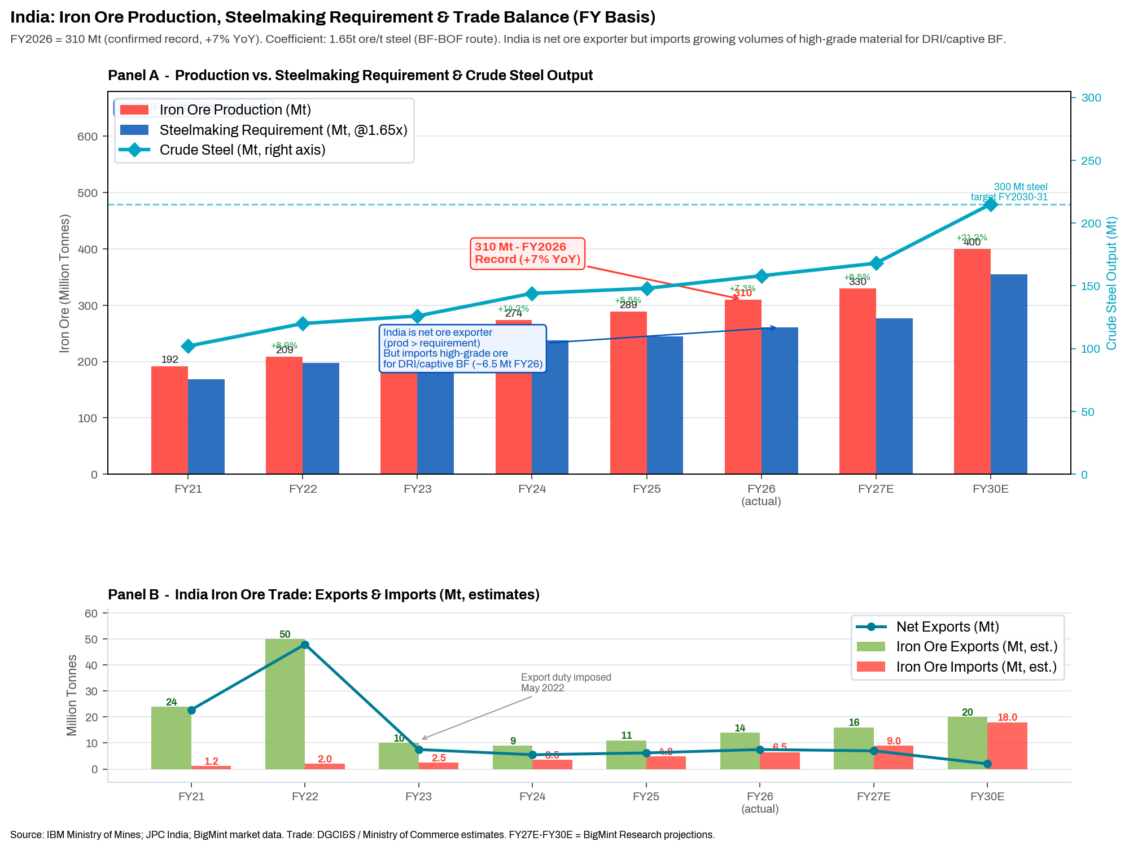
India: FY2026 = 310 mnt output+ Mine Auction Linkage to Global Surplus
06 | INDIA
310 mnt
India FY2026 actual (slower than steel production growth rate of 11% y-o-y, but still +7% YoY) Apr 14 2026
53 mnt
NMDC FY2026 actual (+21% YoY, record)
OMC: 40 mnt (+11%)
289 mnt
India FY2025 (May 2025)
FY2025 ≠ FY2026 - different years
300 mnt
Steel capacity target FY2030-31
Requires ~450-500 Mt ore supply
Mine Auction Linkage: Global surplus → Iron Ore fines index $75-82/dmt base case → import parity pressure → compression of IBM ASP auction mine economics → IRR sensitivity shifts at auctioned mines → future bid aggressiveness re-rates. Direct link to BigMint Mine Auction Economics study.
Market Intelligence | Iron Ore 2030: The Supply Wave | April 2026

Slide 11
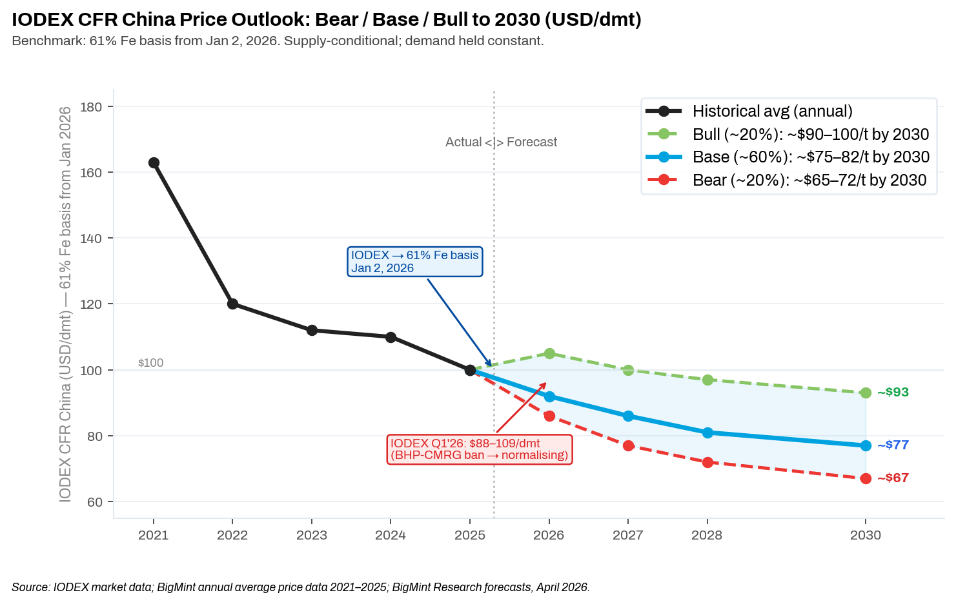
IODEX CFR China (61% Fe): Bear / Base / Bull Price Scenarios to 2030
07 | PRICE
BULL ~20%
~$90-100/dmt by 2030
Simandou delayed · China stimulus · India absorbs · CMRG ban sustained
BASE ~60%
~$75-82/dmt by 2030
Simandou on schedule · China flat to -1% · India +8-12% · Inventory normalises 2027
BEAR ~20%
~$65-72/dmt by 2030
Both Simandou blocks front-load · China -3%+ · Scrap accelerates · Port stocks persist
61% Fe basis note: Q1 2026 IODEX range: $88-109/dmt (Jan low to Mar BHP-CMRG Newman ban spike). Transitional 61/62% spread ~$1.5-2/t through Dec 2027. Scenario ranges supply-conditional.
Market Intelligence | Iron Ore 2030: The Supply Wave | April 2026

Slide 12
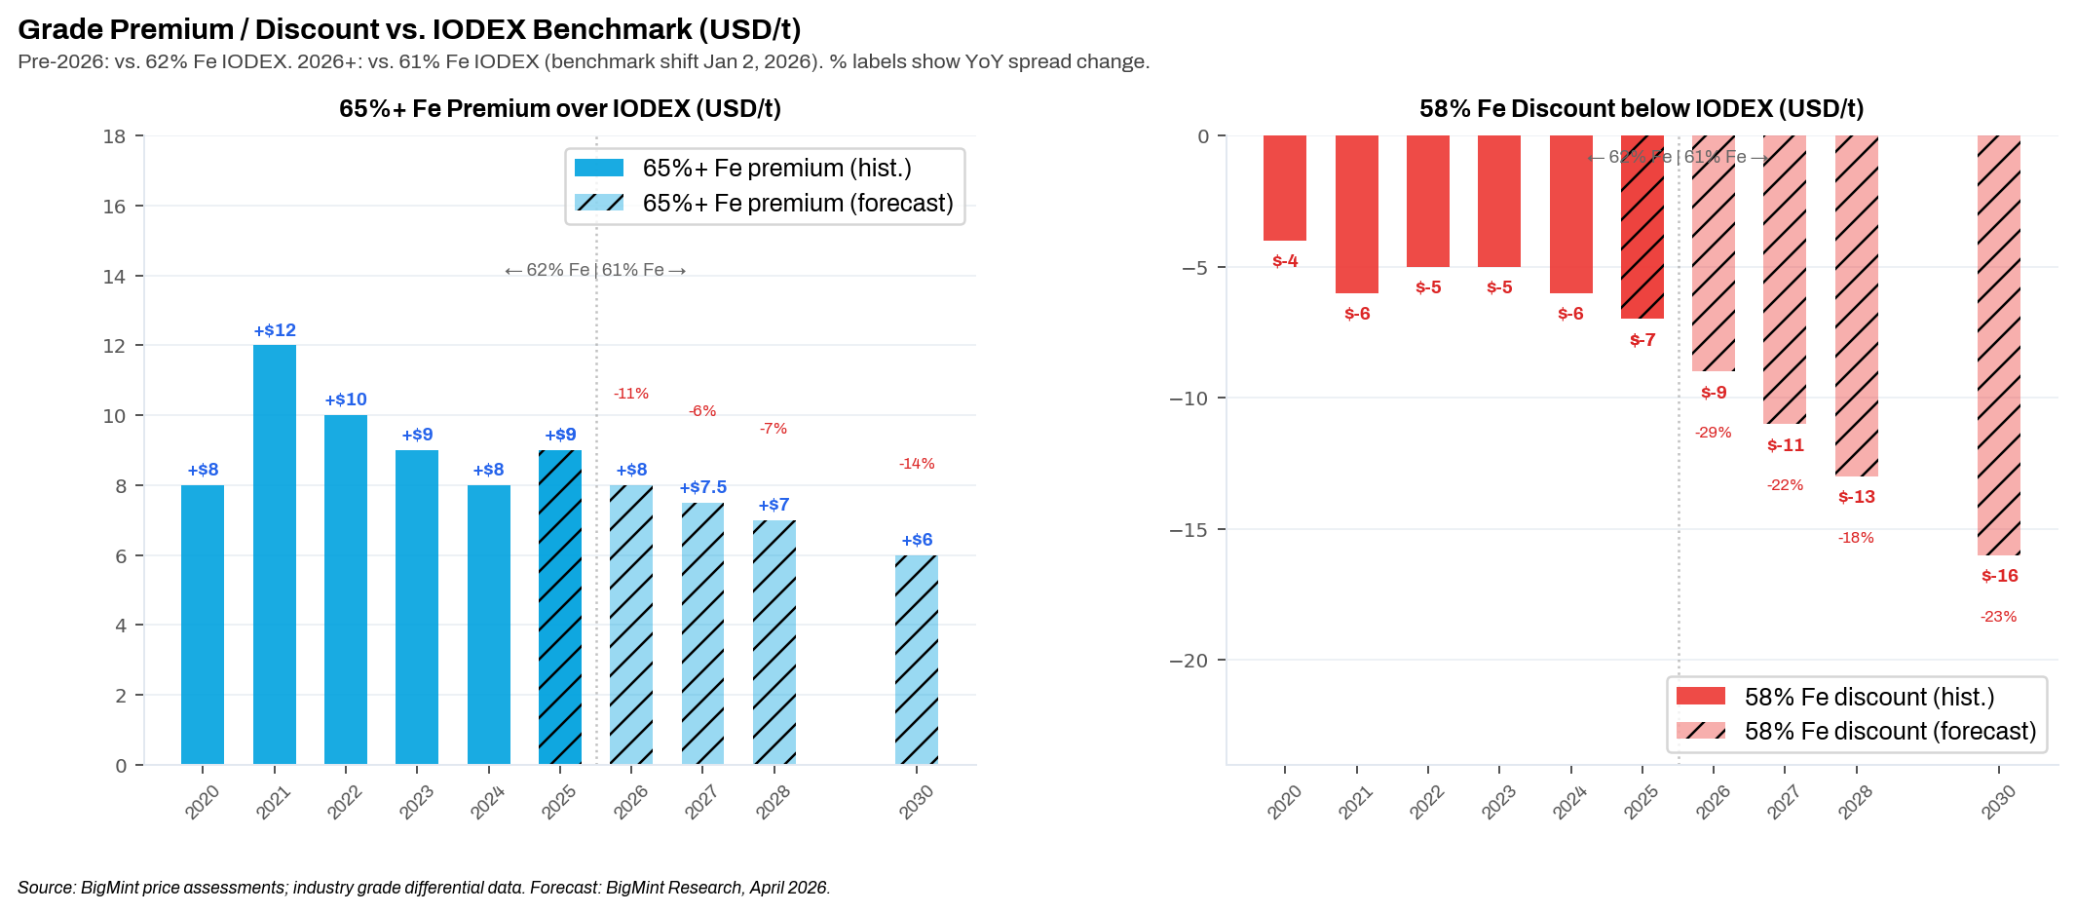
Grade Bifurcation: DR-Grade Resilient; 58% Fe Discount Widens Structurally
07 | PRICE
65%+ Fe: Simandou 65.3% Fe is 4.3% above the new 61% Fe benchmark. DRI/EAF buildout supports demand. Premium compresses from ~$9/t to ~$5-7/t by 2030 as Simandou scales.
58% Fe: Discount widens from ~$7/t to ~$13-16/t by 2030. Mills prefer grade under carbon constraints. Indian BF operators and China domestic ore are most exposed.
Market Intelligence | Iron Ore 2030: The Supply Wave | April 2026

Slide 13
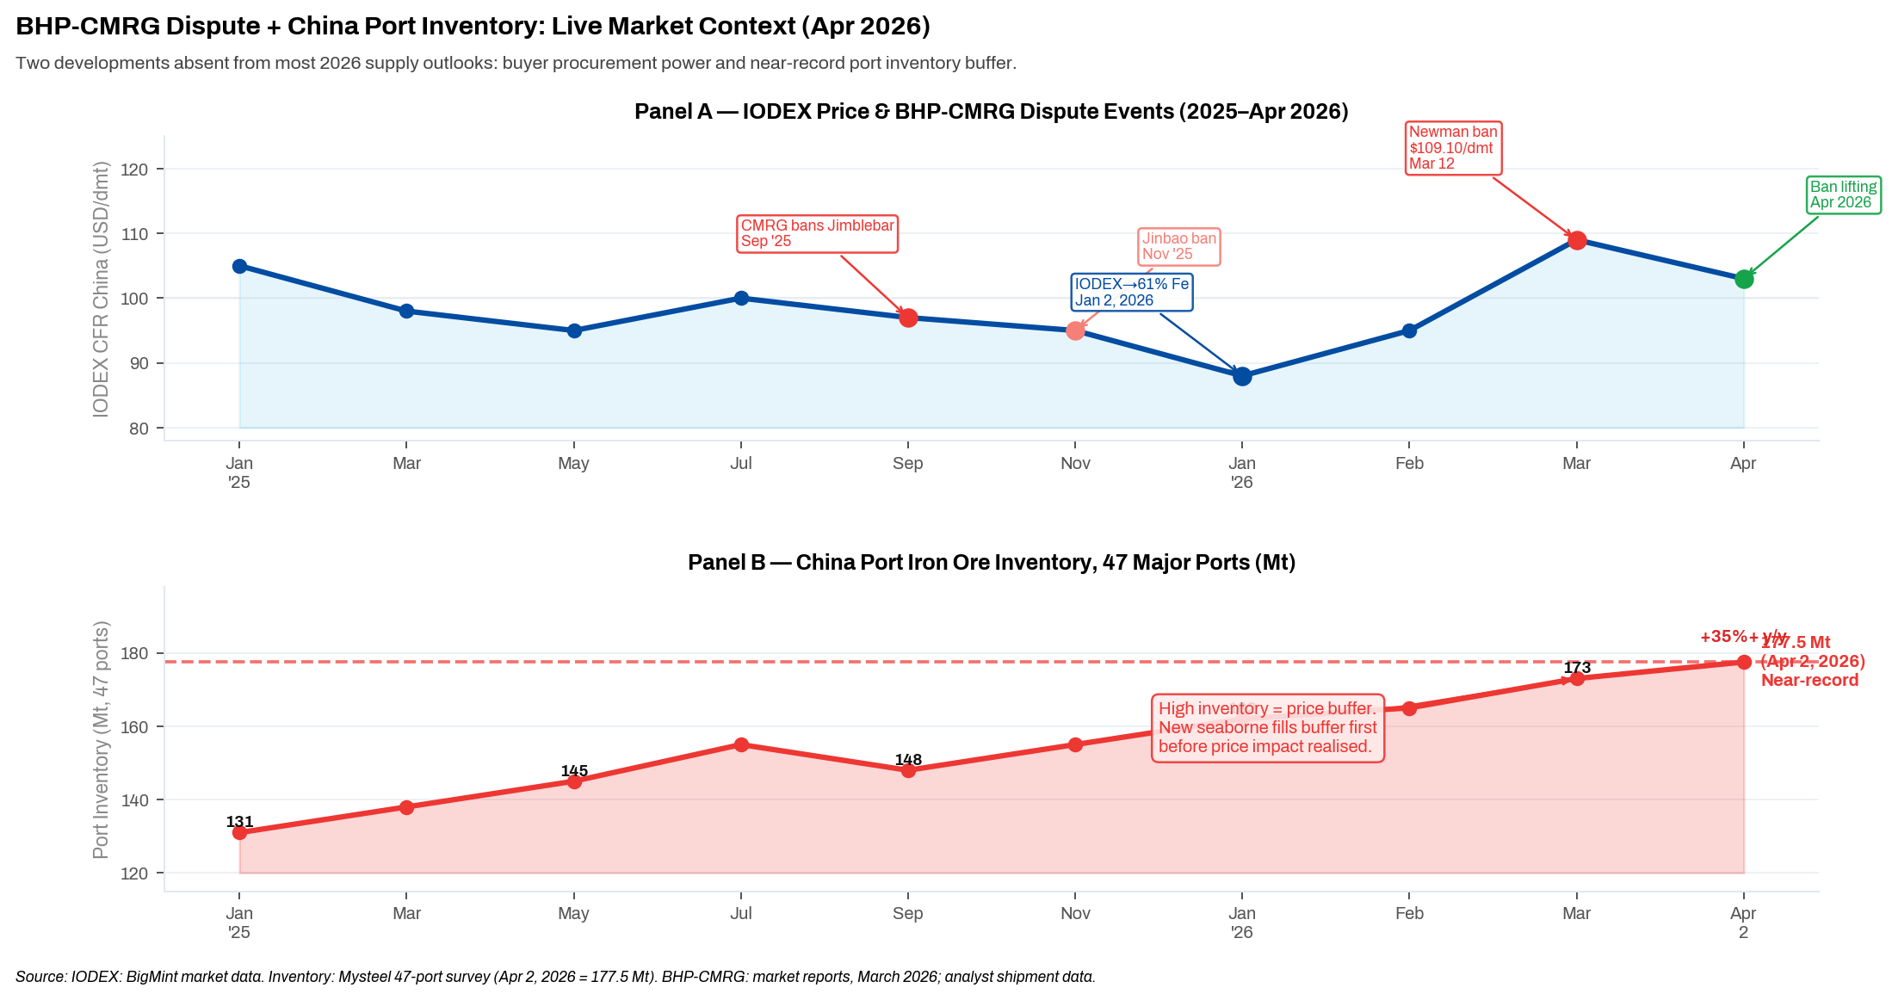
BHP-CMRG Dispute + China Port Inventory: Two Gaps in Most 2026 Outlooks
LIVE CONTEXT
Key insight: 177.5 Mt port inventory (Apr 2 2026, Mysteel) = ~45 days import cover = primary price cap. New seaborne arrivals fill this buffer before price discovery resets. BHP-CMRG ban (lifting Apr'26) adds $5-10/t near-term upside. Both effects absent from most 2026 supply outlooks.
Market Intelligence | Iron Ore 2030: The Supply Wave | April 2026

Slide 14
Key Conclusions - Iron Ore 2030: The Supply Wave
Market Intelligence | April 2026
1. Index is now 61% Fe (from Jan 2, 2026)
All 2026+ price references on 61% Fe basis. Transitional 61/62% spread ~$1.5-2/t through Dec 2027. Scenario ranges unchanged - the basis difference is not material at a 5-year horizon.
2. The surplus is structural around ~67 mnt net new seaborne in CY2026 alone
Multiple independent supply sources arrive concurrently into plateauing demand. China steel output fell 4.4% in 2025. 177.5 Mt port inventory means Stage 1 is a buffer phase; Stage 2 is the price reckoning.
3. Simandou CY2026 = 25-35 Mt combined (NOT 5-10 Mt)
Rio's 5-10 Mt = SimFer equity only. WCS (Baowu 51%) ramping faster, adds ~22 Mt. Combined working estimate 25-35 Mt (mid 29 Mt). Using Rio's figure understates 2026 impact 3-4x.
4. India FY2026 = 310 mnt output
FY2025 = 289 Mt; FY2026 = 310 Mt (+7% YoY). NMDC = 53 Mt (+21%). Different fiscal years; do not conflate.
5. Base case IODEX $75-82/dmt by 2030; grade bifurcation the key strategic variable
DR-grade (65%+ Fe) compresses from top but supported by DRI/EAF demand. 58% Fe discount widens to $13-16/t. India mine auction IRR sensitivity directly linked to this seaborne price trajectory.
Market Intelligence | Iron Ore Supply Outlook 2030 | April 2026

